Slide 1
DIANA miRPath
——Group meeting
18-04-2019
Chengshu
Mora Lab

Slide 2
CONTENTS.
1
Introduction
2
Pipelines
3
Tool practice

Slide 3
1 · Introduction

Slide 4
1.1 Simple introduction
DIANA miR-Path:
DNA Intelligent Analysis of microRNA and Pathways
A microRNA-Pathway analysis web-server, providing accurate statistics and being able to accommodate advanced pipelines

Slide 5
1.2 Why we need DIANA
related
Genes
Pathways
related
related
MicroRNAs
Estimate the impact of co-expressed miRNAs in biological pathways.

Slide 6
1.3 Development
V.2.0: Investigating the combinatorial effect of microRNAs in pathways
V.1.0: Integrating human and mouse microRNAs in pathways
V.3.0: Deciphering microRNA function with experimental support
Website:
V.2.0: http://www.microrna.gr/miRPathv2/
V.3.0: http://snf-515788.vm.okeanos.grnet.gr/
Reference:Vlachos, et al(2009,2012,2015)

Slide 7
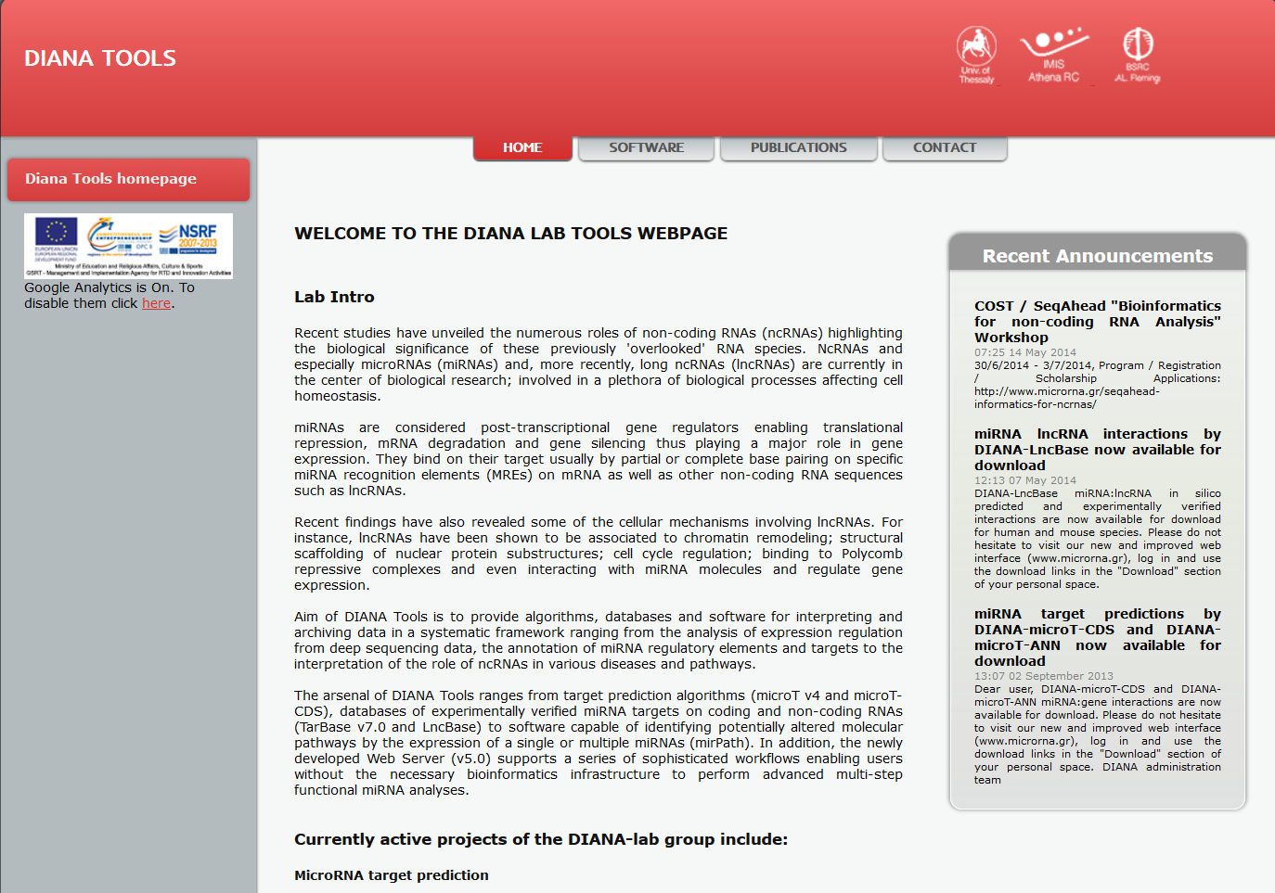
1.4 web interface
V.3.0: http://diana.imis.athena-innovation.gr/DianaTools/index.php?r=site/index
Reference:Vlachos, et al(2009,2012,2015)

Slide 8
2 · Pipelines

Slide 9
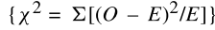
2.1 V.1.0
1. a list of miRNAs
2. three miRNA target prediction programs:
DIANA-microT(2009)、
PicTar(2005)、
TargetScan(2005)
Input: a list of miRNA target genes
Pearson’s chi-squared test
O (Observed) : the number of genes in the input dataset found to participate in a given pathway
E (Expected) : the number of genes expected by chance, given the pathway and input list size, to be member of that pathway.
The input dataset enrichment in each KEGG Pathway is represented by the negative natural logarithm of the P-value (–ln P).
The algorithm also performs an enrichment analysis of the Union and Intersection sets.
Analysis:enrichment analysis of input datasets by comparing each set of genes to all available biological pathways from KEGG
Output: List of target pathways

Slide 10
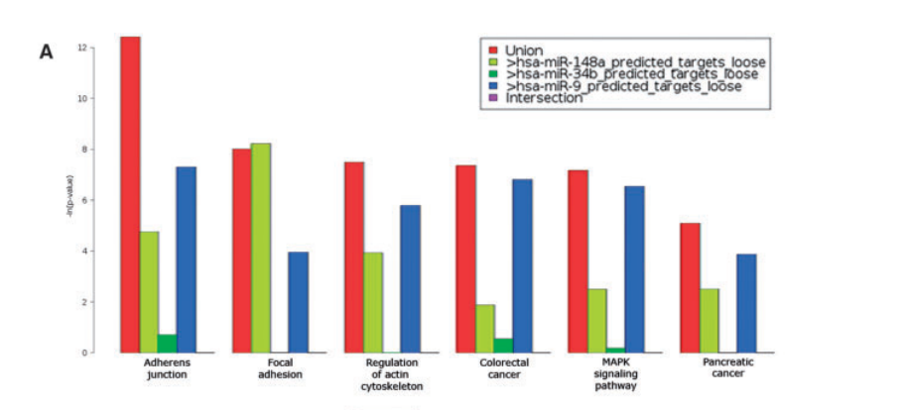
2.1 V.1.0
Enrichment P-value of the Union dataset in a specific pathway will reflect the coordinated downregulation of the pathway by all co-expressed miRNAs whereas the Intersection dataset gives an overview of the cooperative downregulation of single genes by all of the expressed miRNAs.
The combinatoial effect of the miRNA signature is visible in the bar plot graph of the –ln P values. Reference:Vlachos, et al(2009)
DIANA-mirPath V.1.0 is developed in order to estimate the impact of co-expressed miRNAs in biological pathways.

Slide 11
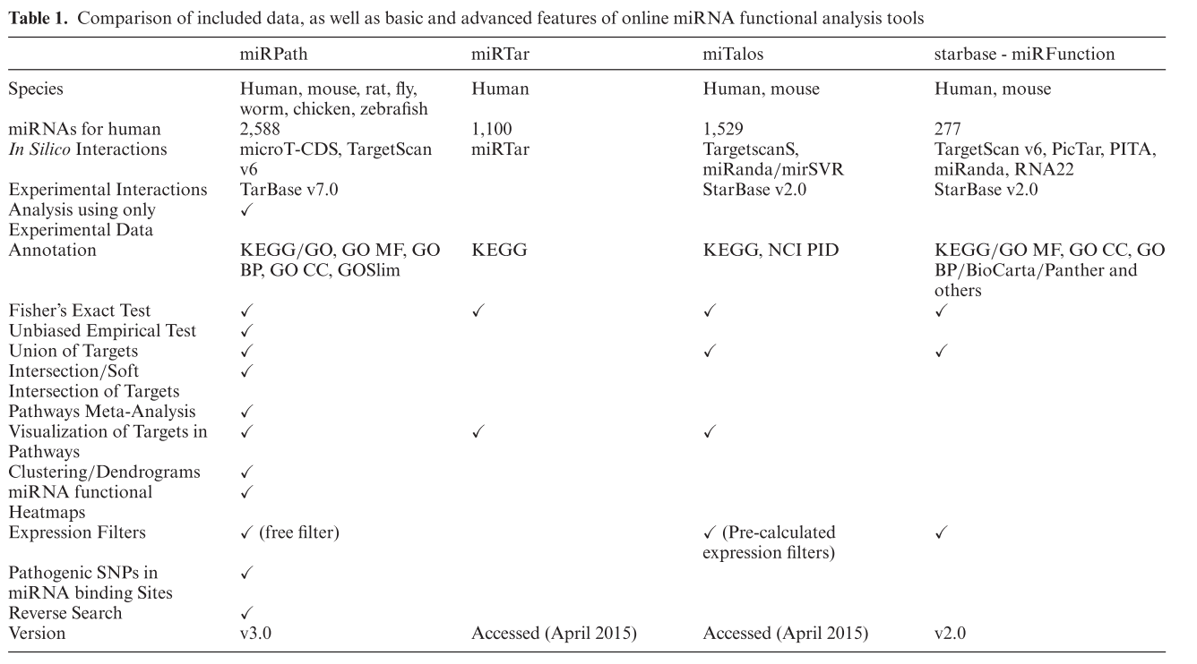
2.2 comparison
V.1.0
the miRNA name and the target prediction software of preference
DIANA-microT (Maragkakis et al., 2009), PicTar (Krek et al., 2005)
TargetScan (Lewis et al., 2005)
Pearson’s chi-squared test
no heatmap and clustering images
Vlachos, et al(2009,2012,2015)

Slide 12
3 · Tool practice

Slide 13
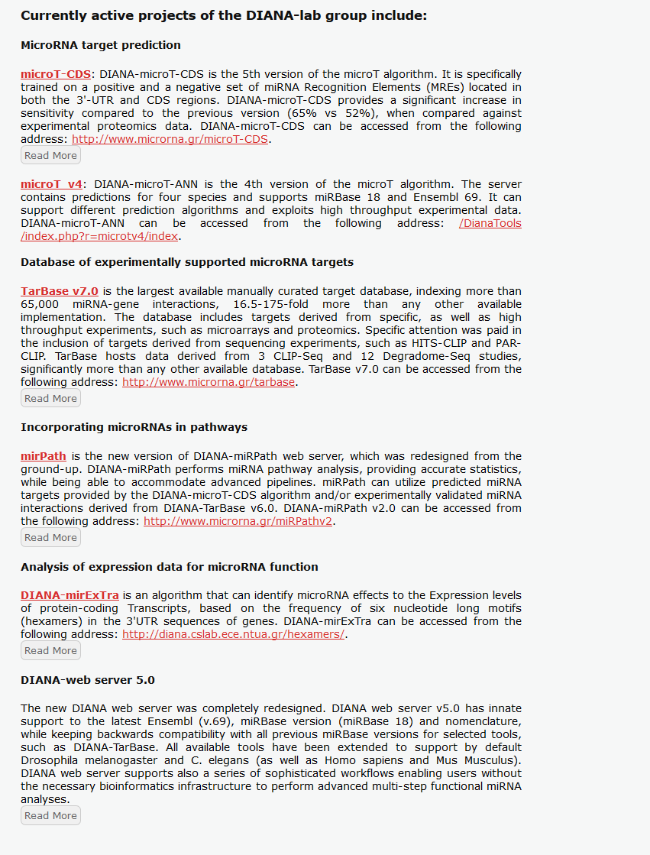
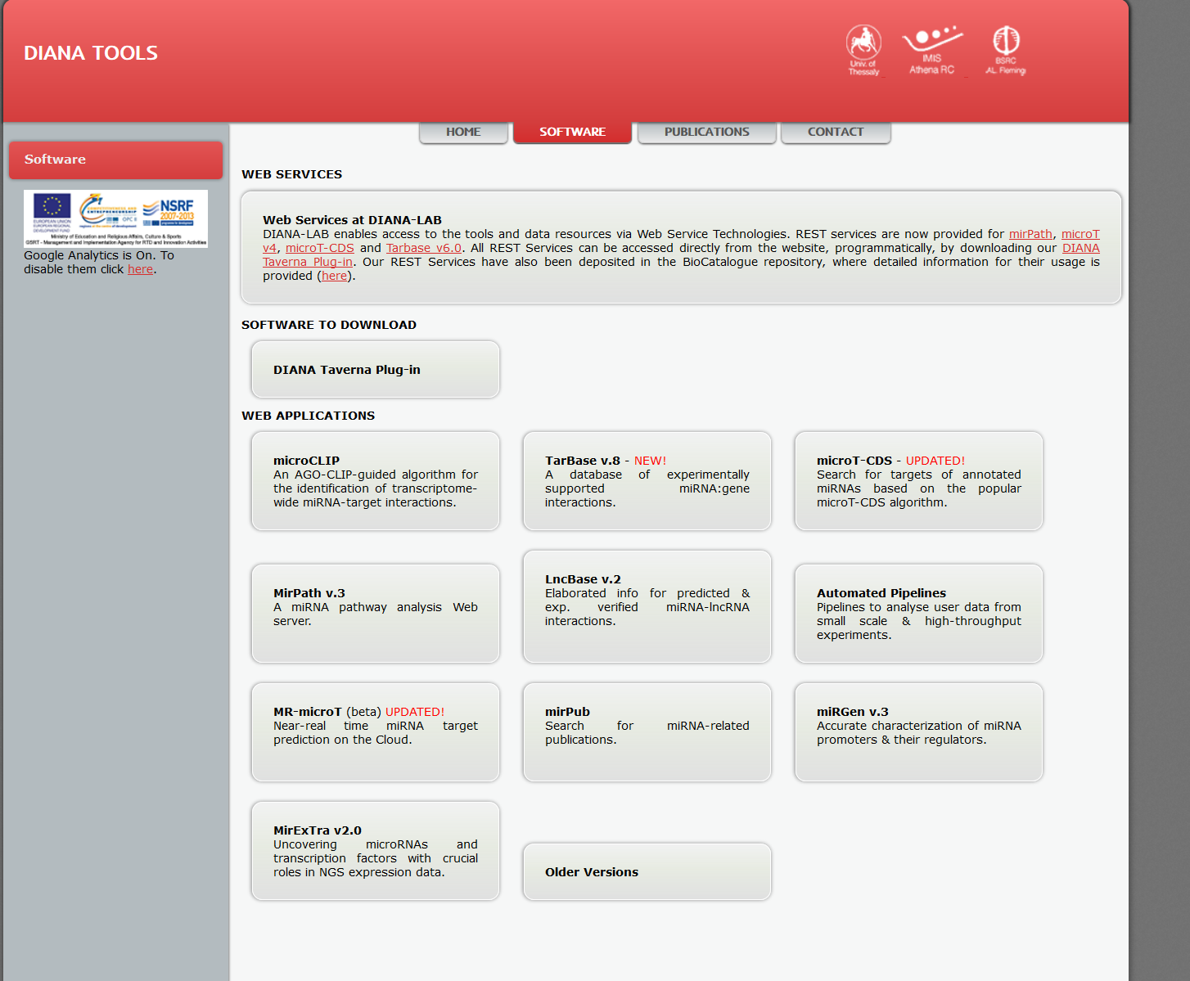
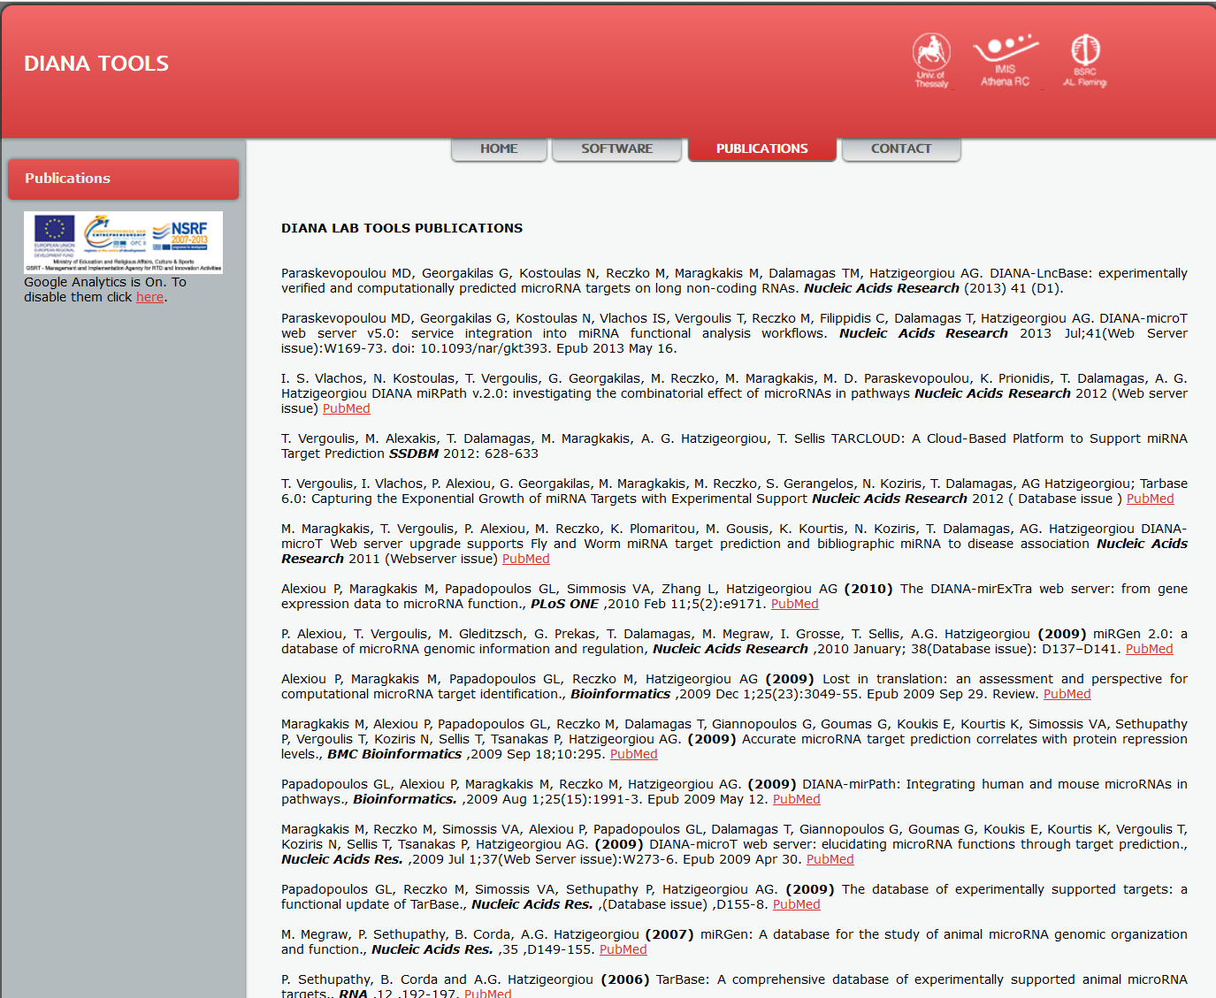
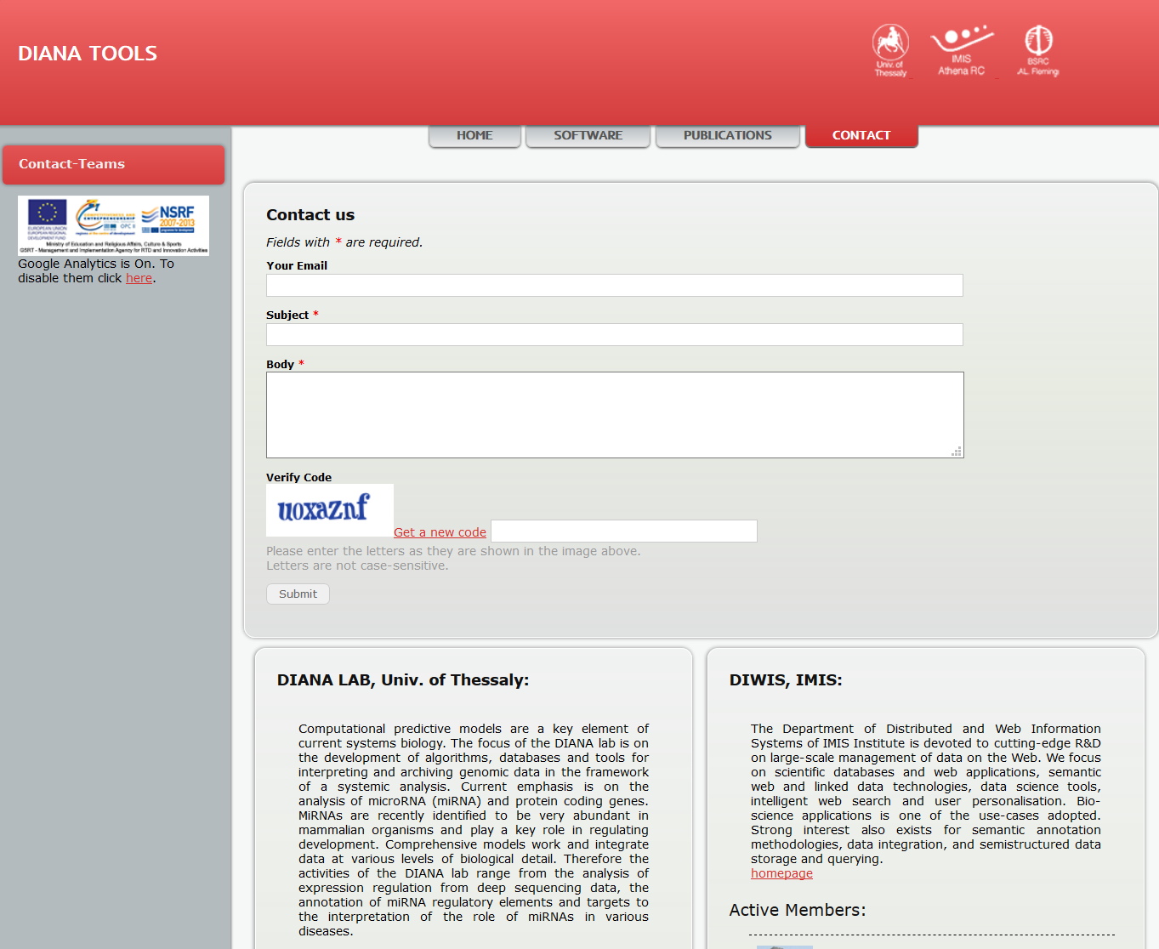
3.1 Web Interface
http://diana.imis.athena-innovation.gr/DianaTools/index.php?r=site/index

Slide 14
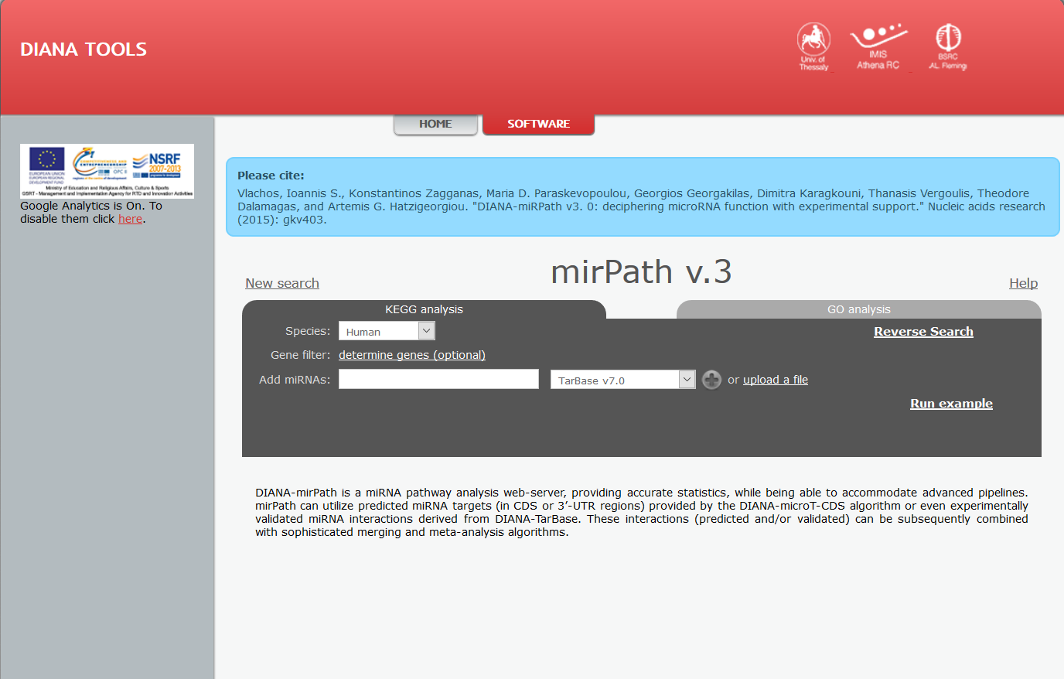
3.2 Software

Slide 15
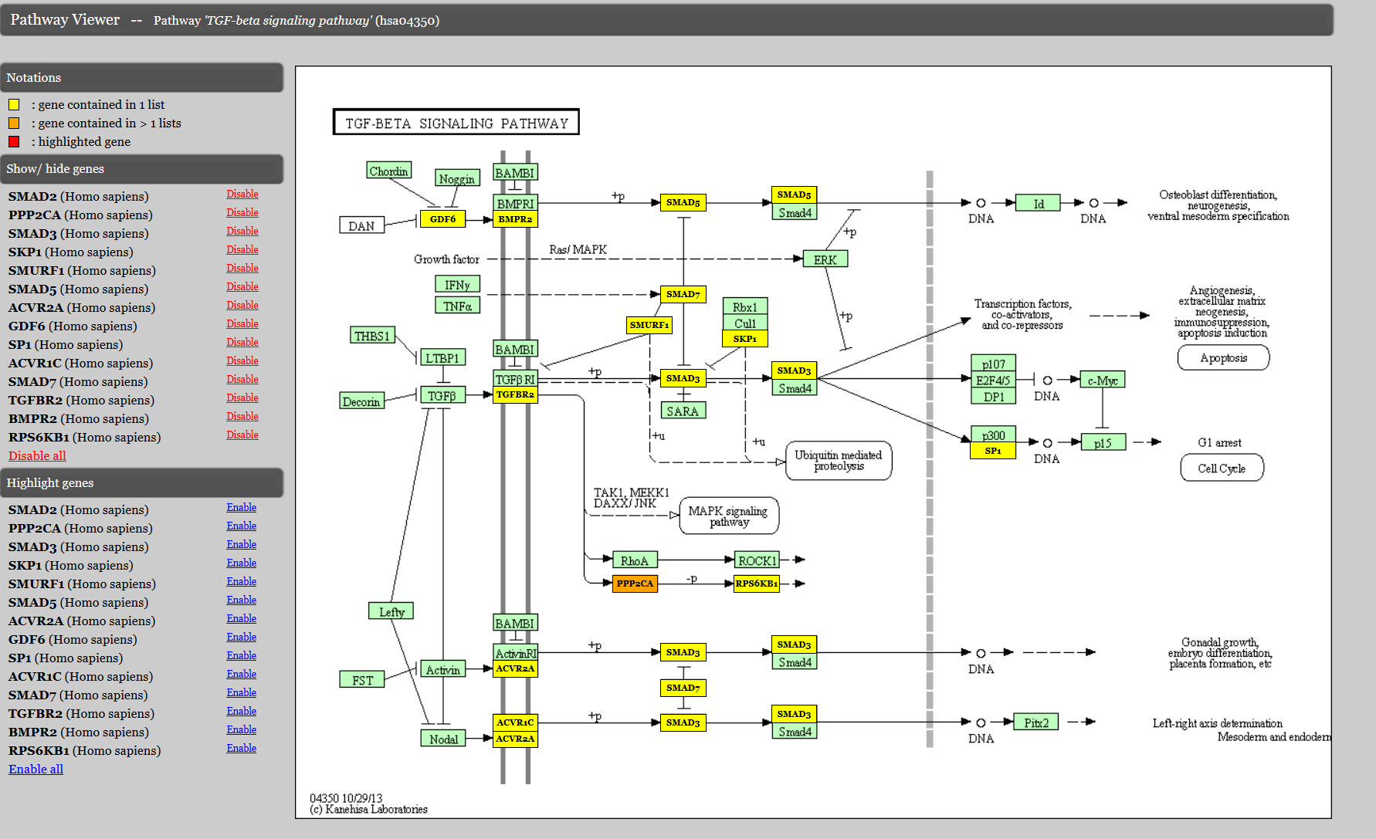
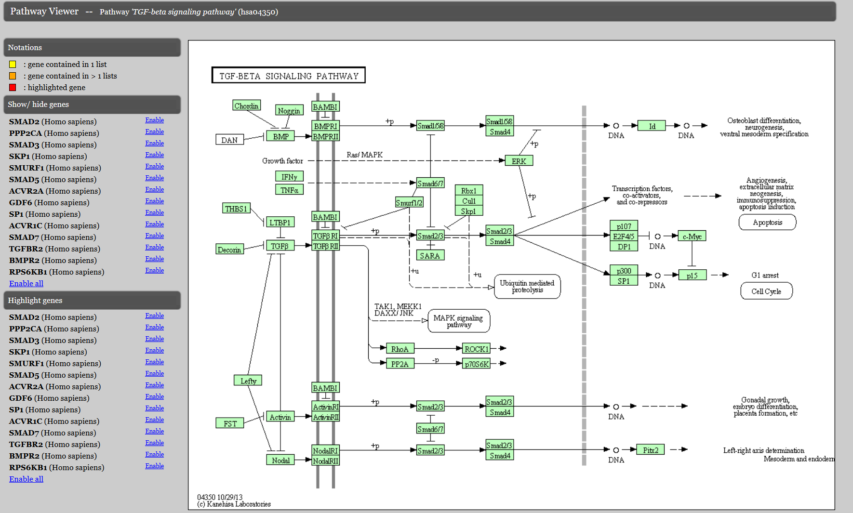
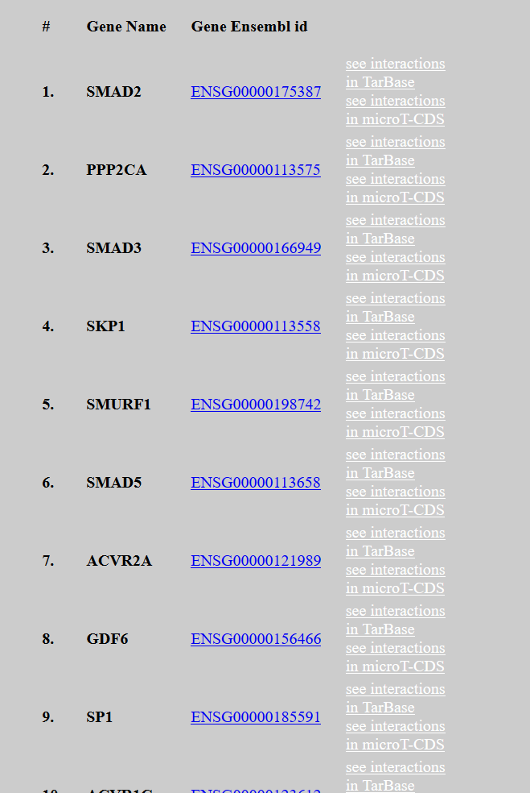
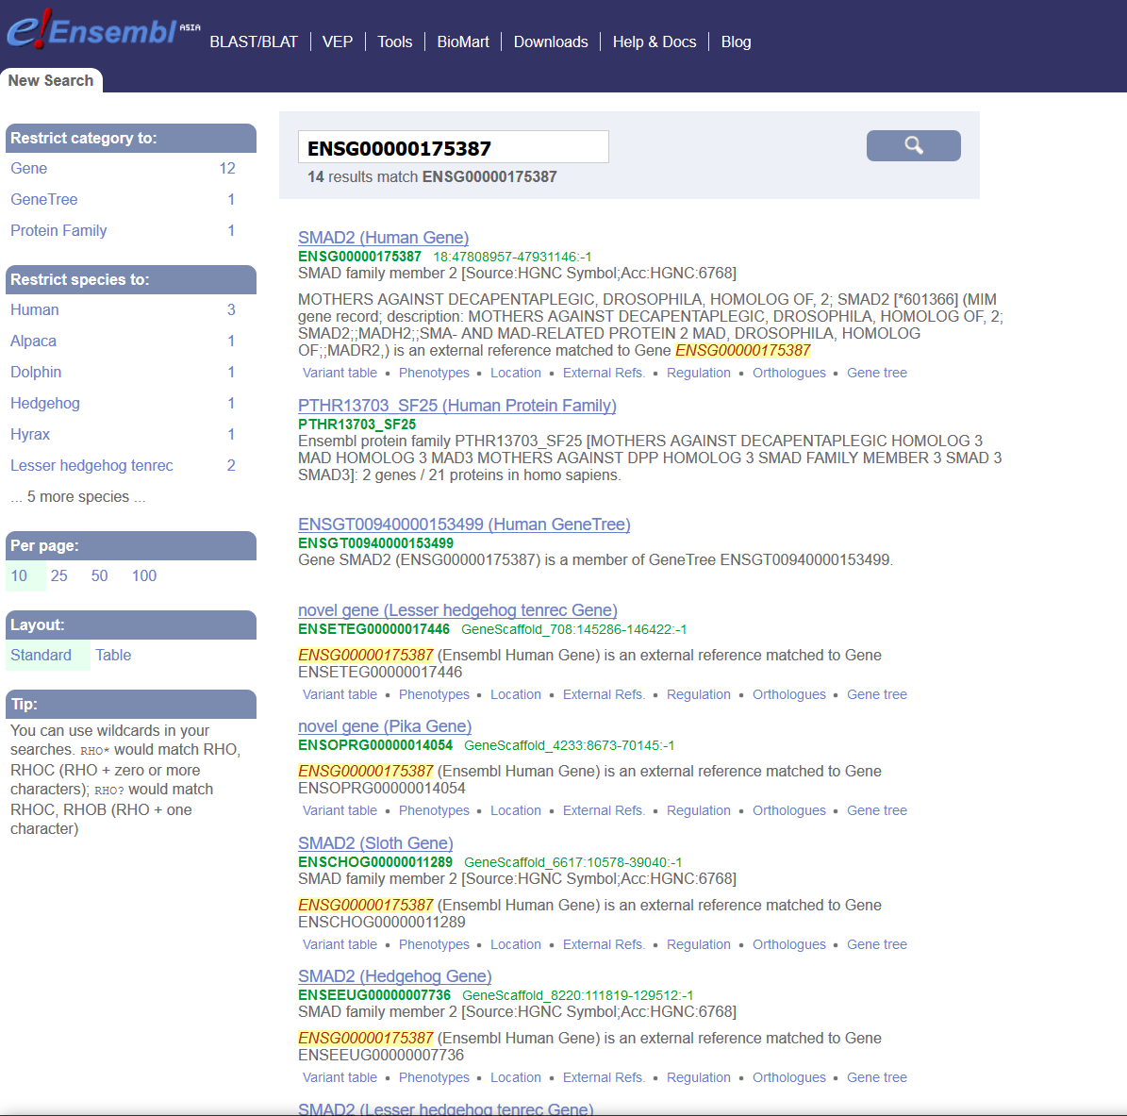
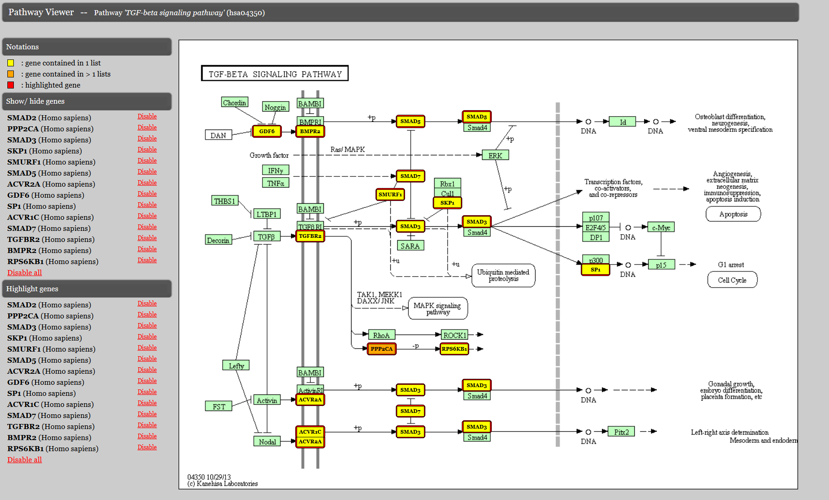
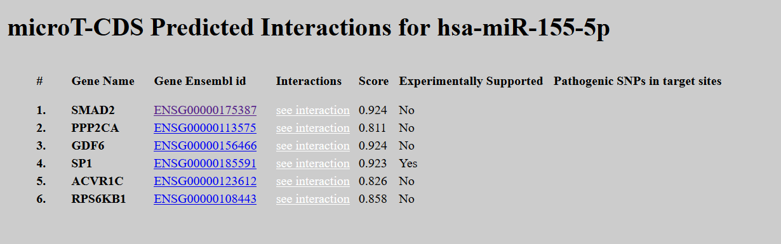
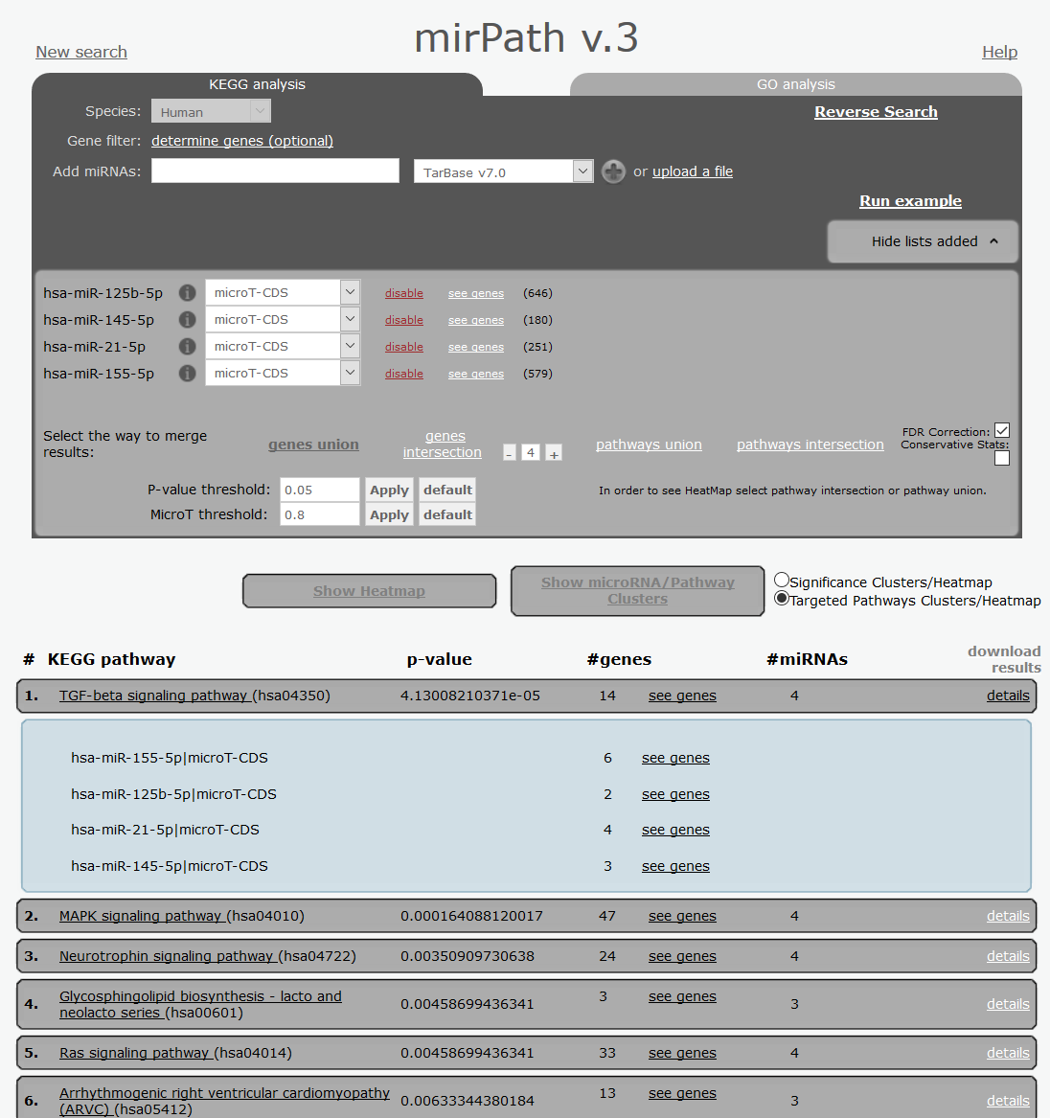
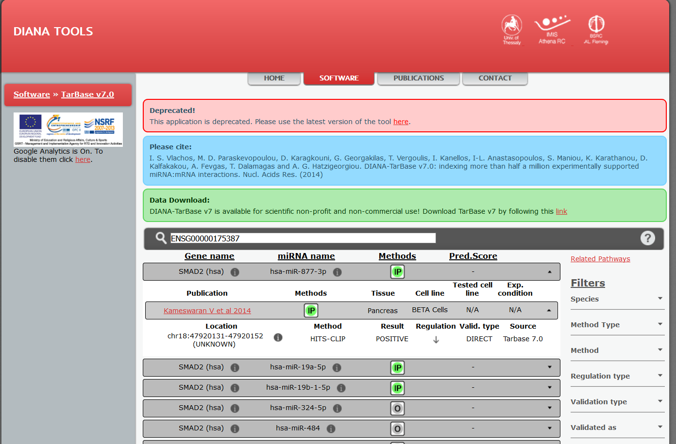
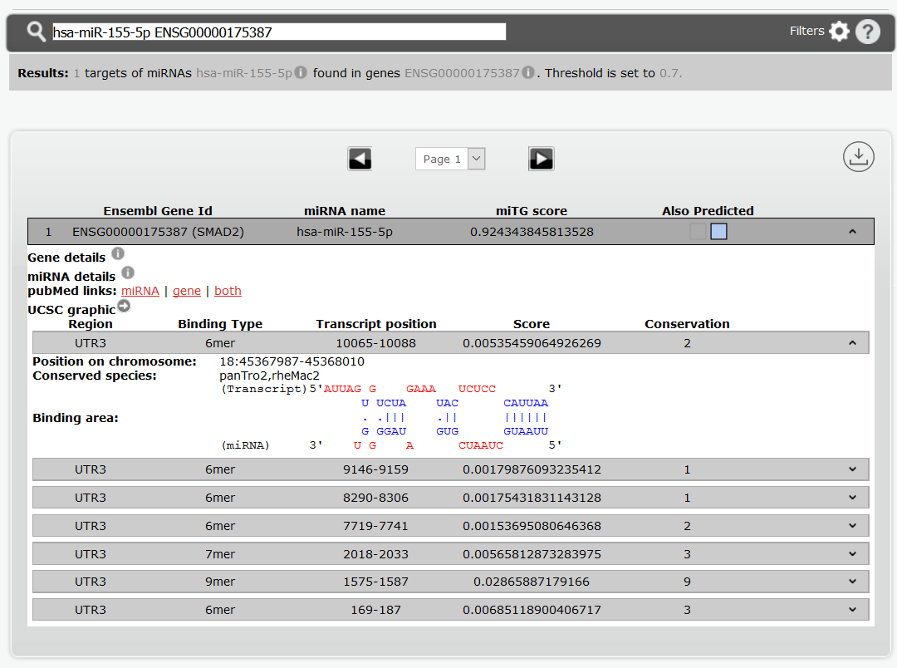
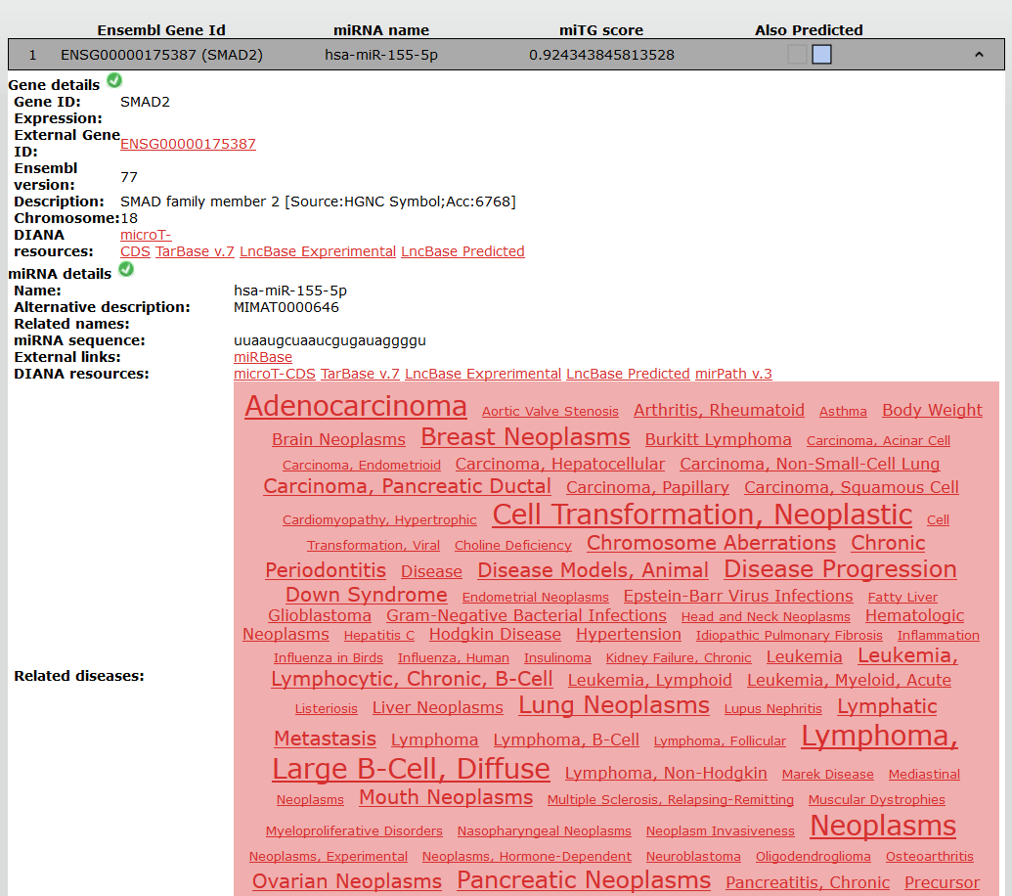
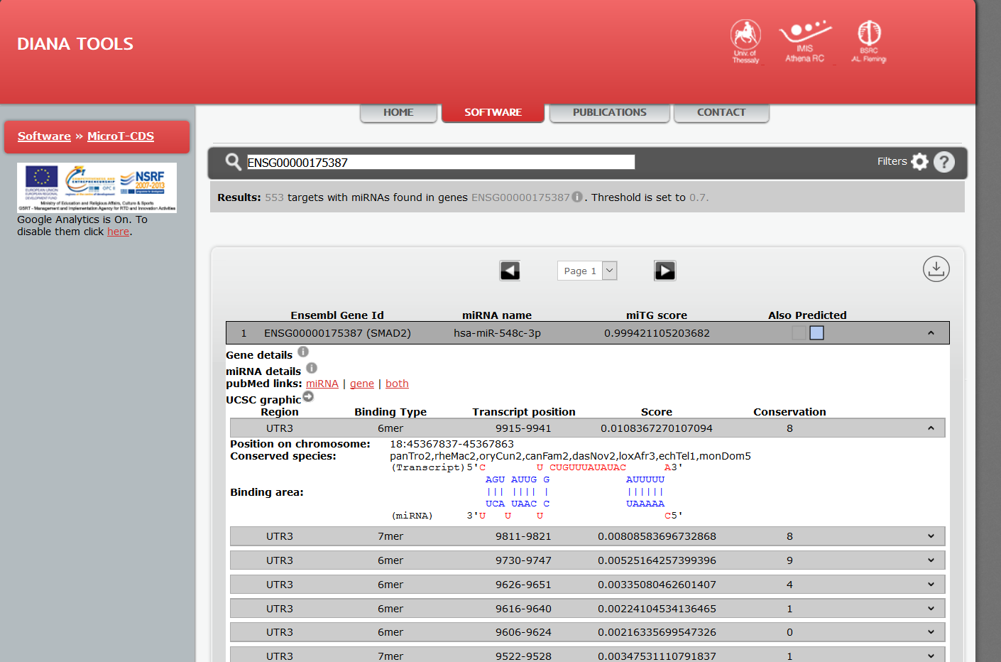
3.2 Software
1
Basic Option
Merging Algorithm &
FDR/EASE Score &
Thresholds
3. Images
(heatmap/ clustering)
2
3

Slide 16
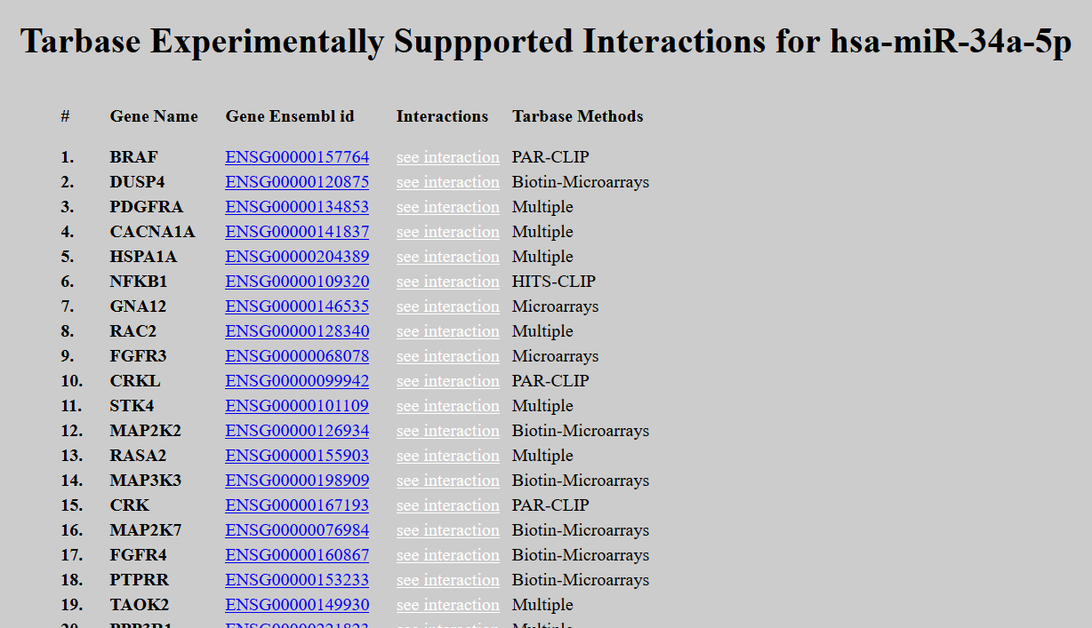
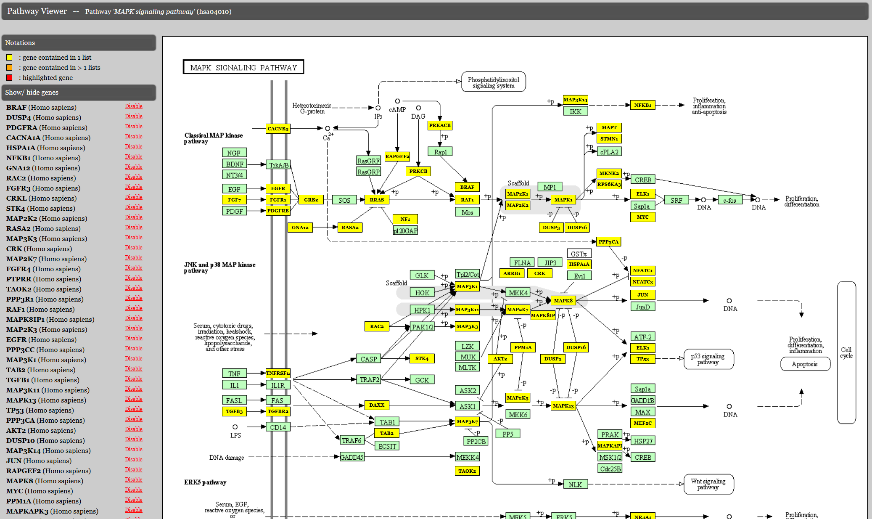
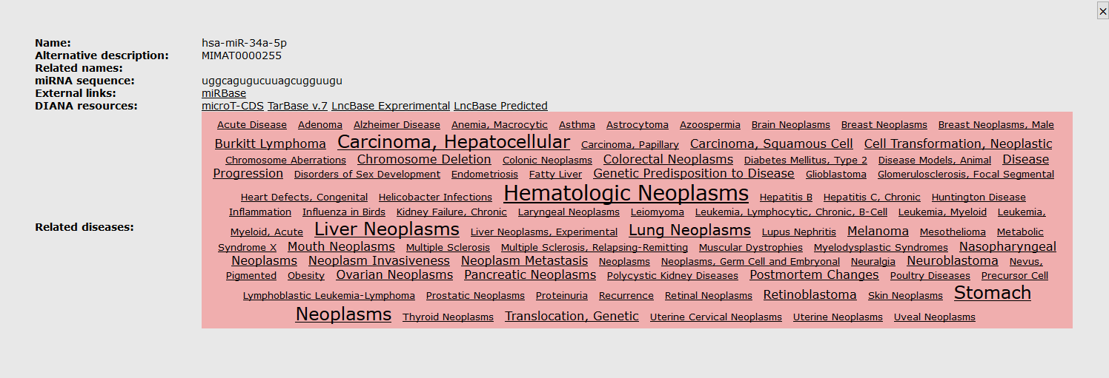
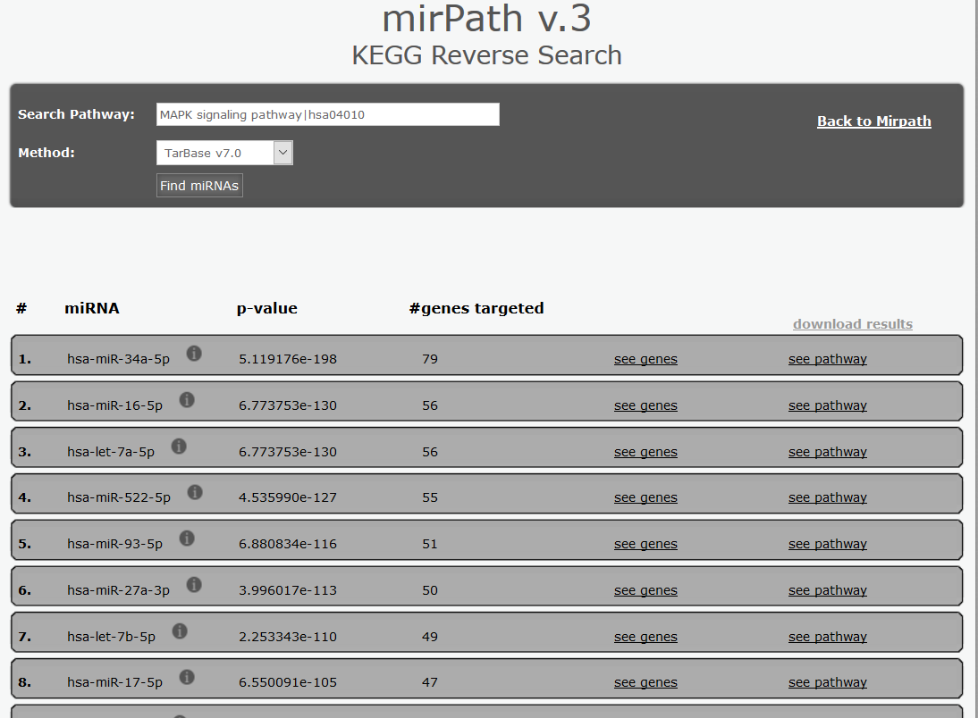
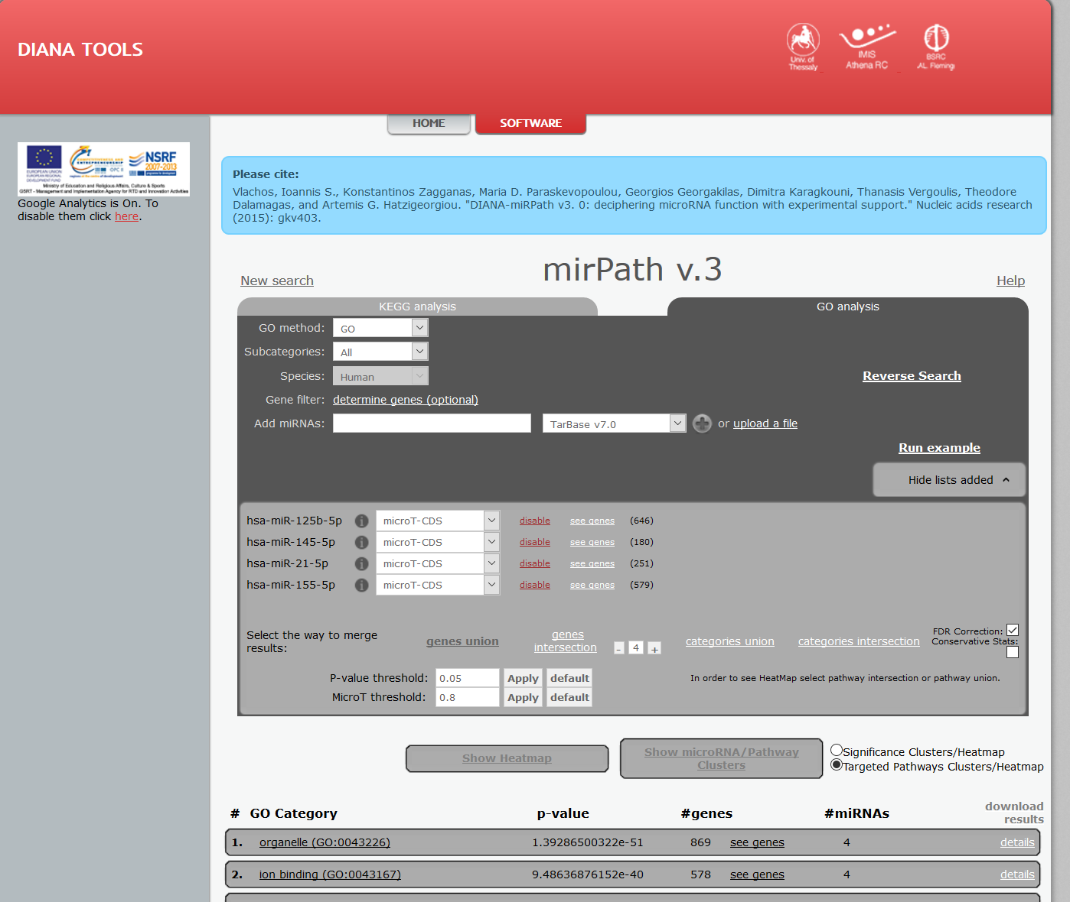
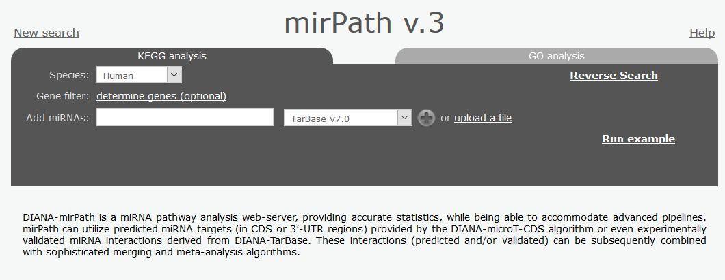
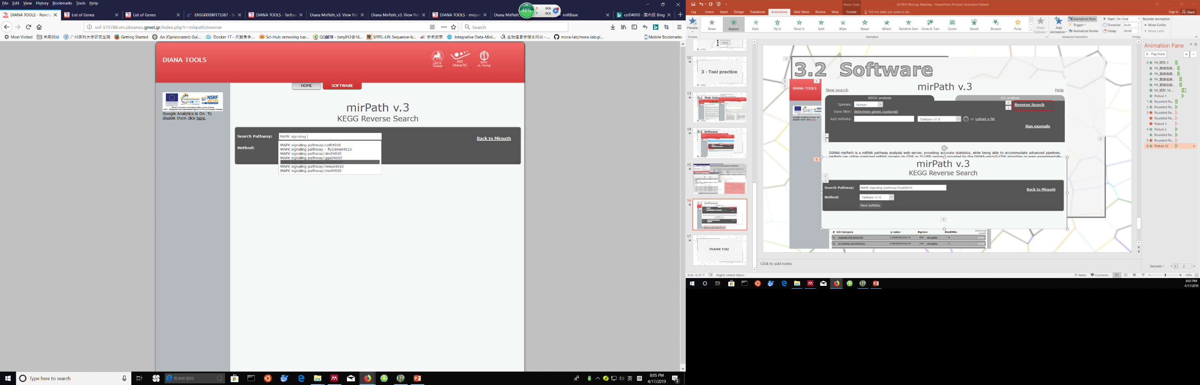
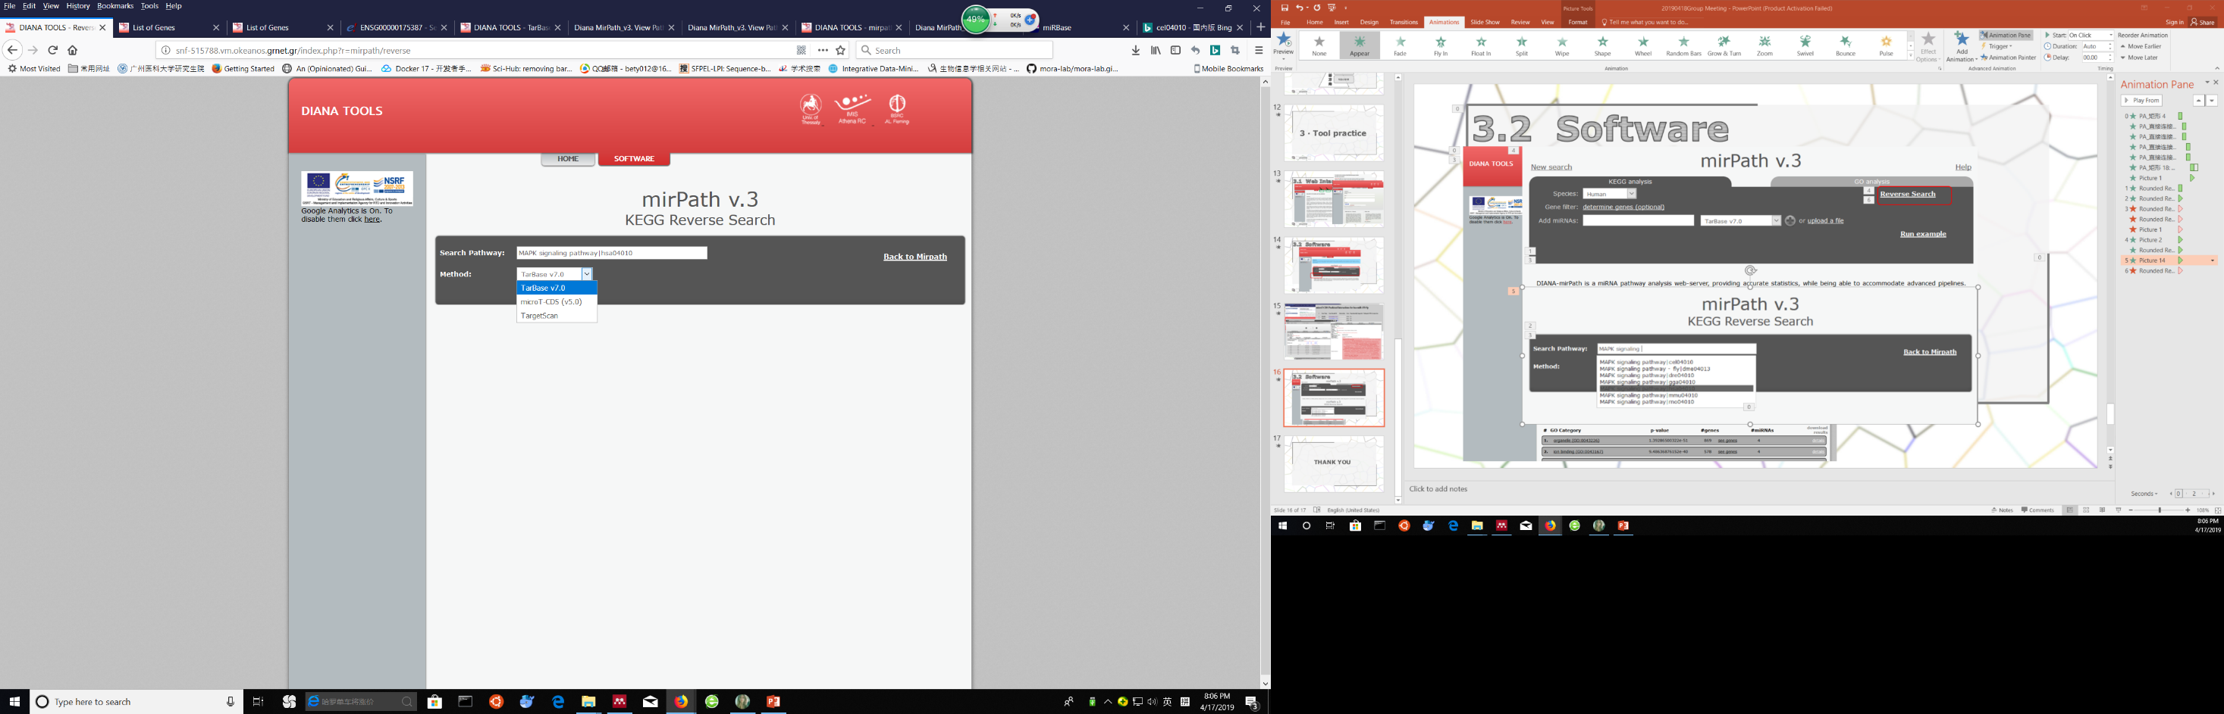
3.2 Software

Slide 17
THANK YOU

